Slide 1


DNS & Naming Scheme
SE3331-1 (2025 Fall)
IPADS, Shanghai Jiao Tong University
https://www.sjtu.edu.cn

Slide 2
The Design of DNS
Domain Name Service

Slide 3
DNS: Binding IP and Domain Name
Names: hostname strings
  E.g., www.sjtu.edu.cn
Values: IP addresses
  E.g., 202.120.2.119
Look-up algorithm
  Resolves a hostname to an IP address so that your machine knows where to send packets

Slide 4
IP Address as a Type of Name
An IP address itself is a type of name
  A structured name that is used to locate an object
  Use IP address to identify the server
    Recall your labs in ICS on socket
  On Internet
    The router will know where to send a packet with destination IP
Hostname has no such semantic
  A router does not know how to send a packet to "baidu.com"

Slide 5
Why Not Just Using IP Address?
IPs are structured in a particular way for routing
  You cannot choose your IP address as you wish
    Note: usually an address cannot be picked
  While you can choose your host names
IPs are not user-friendly enough

Slide 6
Questions on DNS
Q: Can a name have multiple values (IP addresses)?
  Yes. This allows a web server to balance its load over multiple machines
  Also allows a client to choice a nearest IP to access
Q: Can a single value have multiple names?
  Yes. This allows server consolidation
Q: Can the value corresponding to a name change?
  Yes. This allows to change the physical machine (with different IP) that stores the data without changing the hostname
  Such changing is hidden to clients

Slide 7
Look-up Algorithm
At first, each machine kept a "hosts.txt" for address binding
  E.g., "r900 202.120.224.83"
  Using table look-up to resolve the binding
  This method cannot scale in Internet
1984, four Berkeley students wrote BIND
  Berkeley Internet Name Domain
  Still the dominant DNS software in use

Slide 8
Distributing Responsibility
The binding
  Too large to be stored on a single machine
  Thus, the data are stored on many machines
    As known as "name servers"
How to know which name server has a particular binding?
  Solution: structure the hostname
  Names have a hierarchy, e.g., com, net, gov, correspond to "zones"
  Zones are mapped to name servers

Slide 9

Name Servers
The root zone
  Maintained by ICANN, non-profit
The ".com" zone
  Maintained by VeriSign, add for money
The ".sjtu.edu.cn" zone
  Maintained by SJTU

Slide 10
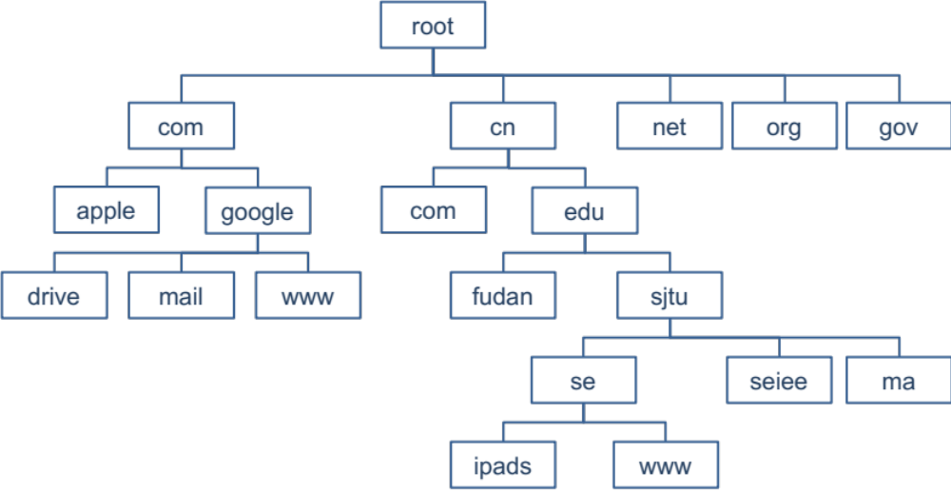
DNS Hierarchy (a partial view)

Slide 11
Basic DNS Look-up Algorithm
Example: lookup IP of "ipads.se.sjtu.edu.cn"
Traverse the name hierarchy from the root
  The root will tell us the "cn" name server IP,
  which will tell us the "edu.cn" name server IP,
  which will tell us the "sjtu.edu.cn" name server IP,
  which will tell us the "se.sjtu.edu.cn" name server IP,
  which finally tells us the "ipads.se.sjtu.edu.cn" IP
Such algorithm is called delegation

Slide 12
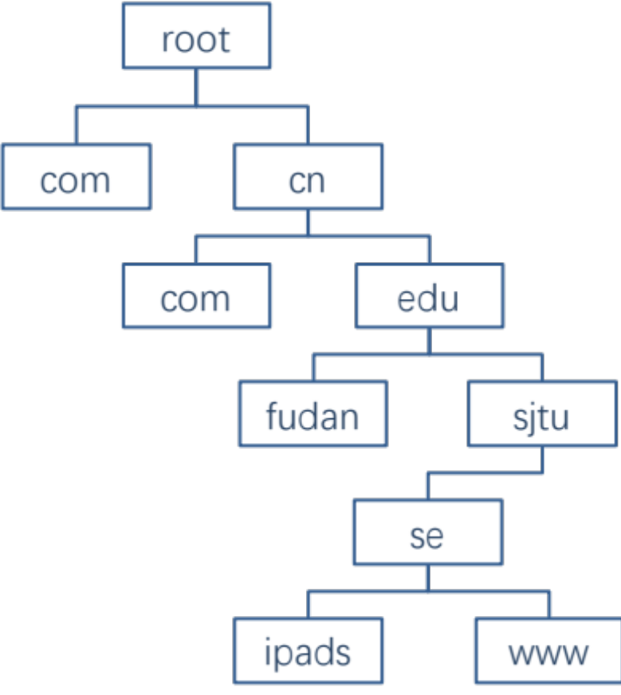
DNS Lookup

Slide 13
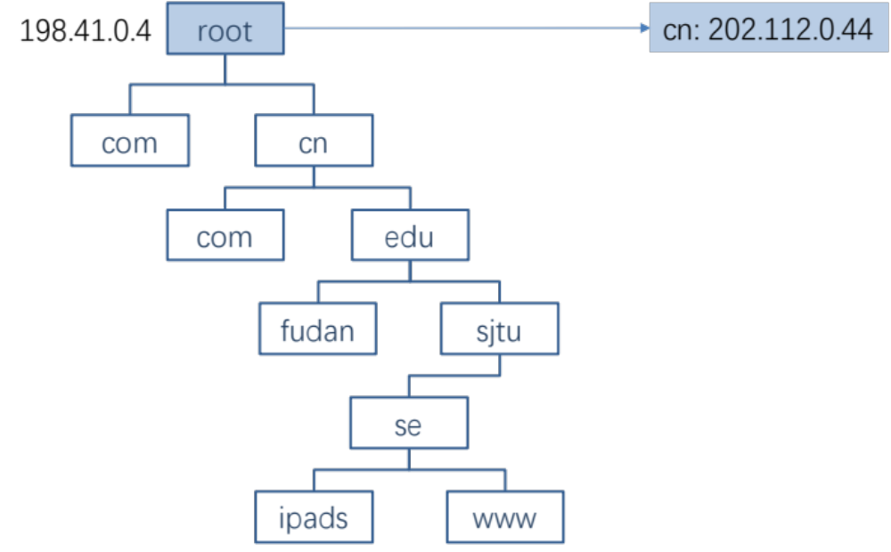
DNS Lookup

Slide 14
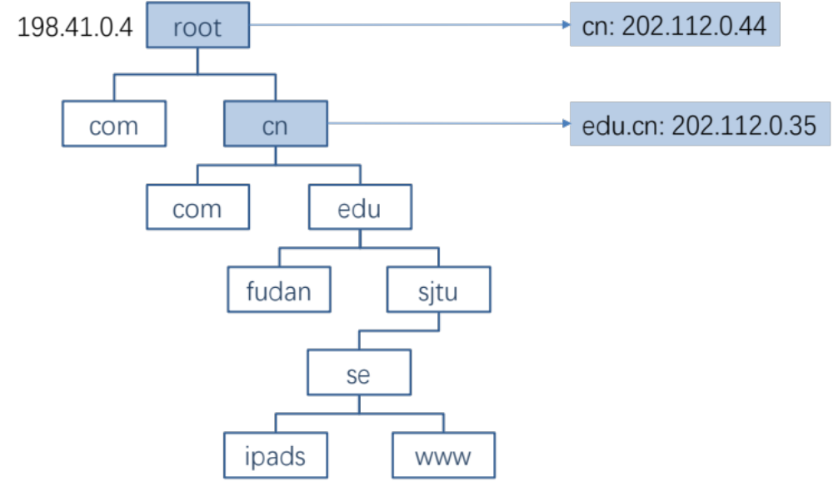
DNS Lookup

Slide 15
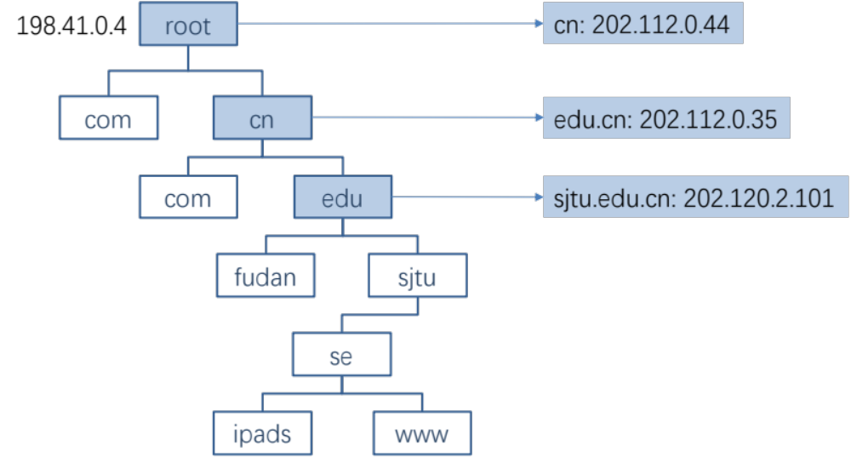
DNS Lookup

Slide 16
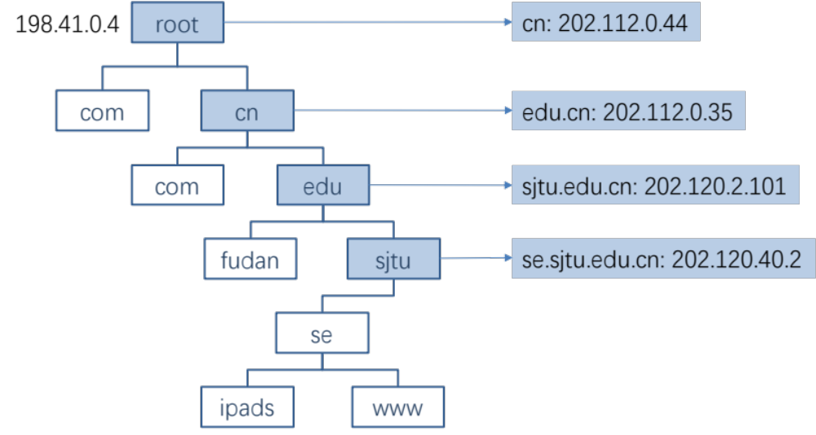
DNS Lookup

Slide 17
Context in DNS
Names in DNS are global (context-free)
  A hostname means the same thing everywhere in DNS
Actually, it should be "ipads.se.sjtu.edu.cn."
  A hostname is a list of domain names concatenated with dots
  The root domain is unnamed, i.e., "." + blank

Slide 18
Fault Tolerant
Each zone can have multiple name servers
  A delegation usually contains a list of name servers
  If one name server is down, others can be used

Slide 19
Three Enhancements on Look-up Algorithm
1. The initial DNS request can go to any name server, not just the root server
  Even on your own machine: /etc/hosts
  You can specific name servers in /etc/resolv.conf
  If no record, just return address of the root server
  Q: what are the benefits?
Notes:
To minimize the load of the root server.

Slide 20
Three Enhancements on Look-up Algorithm
2. Recursion
  A client asks a name server "www.baidu.com"
  The name server does all the lookup through the tree and return the IP of Baidu to the client
  Usually, a name server has a better network connection

Slide 21
DNS Request Process
a.root.net
a.root.net
names.edu
names.edu
NS: for edu
ns.iss.edu
ns.iss.edu
NS: for
Scholarly.edu
ginger.
Scholar.edu
ginger.
Scholar.edu
ginger.
Scholar.edu
AP: for
ginger.Scholar.edu
Name client
Name client
Non-Recursion
Recursion

Slide 22
Three Enhancements on Look-up Algorithm
3. Caching
  DNS clients and name servers keep a cache of names
    Your browser will not do two look-ups for one address
  Cache has expire time limit
    Controlled by a time-to-live parameter in the response itself
    E.g., SJTU sets the TTL of www.sjtu.edu.cn to 24h
  TTL (Time To Live)
    Long TTL VS. short TTL
    Q: what are the tradeoffs?

Slide 23
Combine These Enhancements
If:
  Many machines at SJTU use the SJTU name server for their initial DNS query, and
  The name server offers recursive querying and caching
Then:
  The name server's cache will hold many bindings, and
  Performance benefits from this large cache

Slide 24
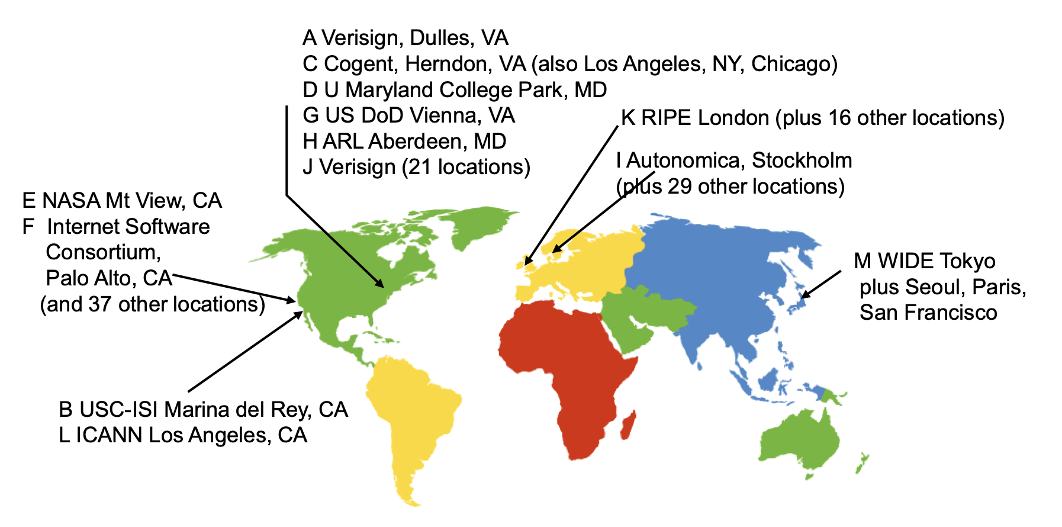
Other Features of DNS
At least two identical replica servers
  80 replicas of the root name server in 2008
  Replicas are placed separated around the world

Slide 25
Other Features of DNS
Organization's name server (e.g., SJTU)
  Several replicas in campus
    To enable communications within the organization
  At least one out of the campus
    To validate the address for outside world

Slide 26
Name Discovery in DNS (at the first place)
A client must discover the name of a nearby name server
  Name discovery broadcast to ISP at first time
  Ask network manager
  Ask by email, Google, etc.

Slide 27
Comparing Hostname & Filename
They are both for more user friendly
  File-name -> inode number
  Host-name -> IP address
  File-name and host-name are hierarchical; inode num and IP addr. are plane
They are both not a part of the object
  File-name is not a part of a file (stored in directory)
  Host-name is not a part of a website (stored on name server)
Name and value binding
  File: 1-name -> N-values (no); N-name -> 1-value (yes)
  DNS: 1-name -> N-values (yes); N-name -> 1-value (yes)

Slide 28
Behind the DNS Design
Why was DNS designed in this way?

Slide 29
Benefits of Hierarchical Design
Hierarchies delegate responsibility
Each zone is only responsible for a small portion
Hierarchies also limit interaction between modules
  A type of de-centralization

Slide 30
Good Points on DNS Design
Global names (assuming same root servers)
  No need to specific a context
  DNS has no trouble generating unique names
  The name can also be user-friendly
Scalable in performance
  Simplicity: look-up is simple and can be done by a PC
  Caching: reduce number of total queries
  Delegation: many name severs handle lookups

Slide 31
Good Points on DNS Design
Scalable in management
  Each zone makes its own policy decision on binding
  Hierarchy is great here
Fault tolerant
  If one name server breaks, other will still work
  Duplicated name server for a same zone

Slide 32
Bad Points on DNS Design
Policy
  Who should control the root zone, .com zone, etc.? Governments?
Significant load on root servers
  Many DNS clients starts by talking to root server
  Many queries for non-existent names, becomes a DoS attack
Security
  How does a client know if the response is correct?
  How does VeriSign know "change Amazon.com IP" is legal?

Slide 33
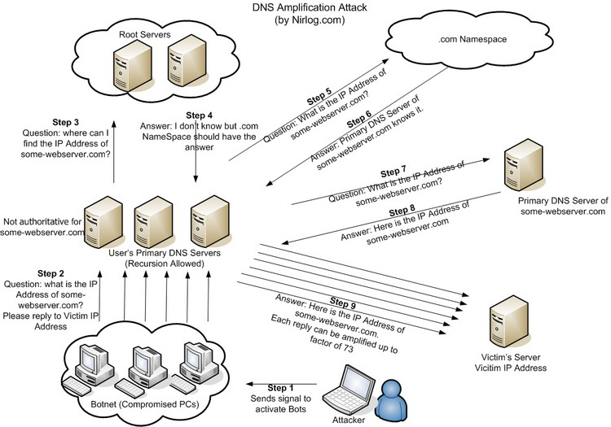
DNS Amplification Attack

Slide 34
DNS Security
DNS Hijack: Cutting the binding between name and IP
DNS DoS (Denial of Service) attack
  BAOFENG.com & DNSPod
  2009-5-18: DNSPod was attacked and banned
  2009-5-19: The Internet in China was almost down
  Fixed timer: query for BAOFENG.com once per second!
Solutions
  /etc/hosts, dnsmasq, OpenDNS, etc.
  DNS shield to defend against DoS attack

Slide 35

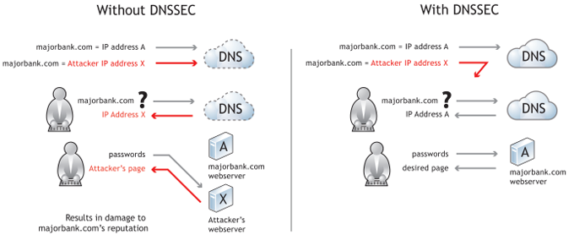
DNSSEC: Protect DNS Record
Only part of the zones are using DNSSEC, e.g., .gov, .org

Slide 36
Content Distribution
Files on the Internet

Slide 37
Content Distribution
How to reduce load latency over Internet?
  Especially for large files, e.g., images and videos
Client side
  Many people from SJTU might access same web pages
  Save bandwidth by caching a local copy
Server side
  Not all clients use cache
  Push data out to content distribution network (CDN)

Slide 38
Caching Examples
Web browser caches recently accessed files
  E.g., allow "back" button to operate more efficiently
Web proxies cache recently accessed URLs
  Save bandwidth/time when multiple people locally access same remote URL
DNS resolvers cache resource records (URL→IP)
NFS clients cache read/written data

Slide 39
Content Distribution Network (CDN)
Network of computers that replicate content across the Internet
  Bringing content closer to requests
  End users only use local (not shared) network capacity
Content providers actively pushes data into the network
  Improve performance and reduce costs

Slide 40
Content Distribution Network (CDN)
Akamai as an example

Slide 41
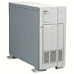

Server Selection Mechanism
Application
  HTTP redirection
Advantages
  Fine-grain control
  Selection based on client IP address
Disadvantages
  Extra round-trips for TCP connection to server
  Overhead on the server
GET
Redirect
GET
OK

Slide 42
Server Selection Mechanism
Routing
  Anycast routing
Advantages
  No extra round trips
  Route to nearby server
Disadvantages
  Does not consider network or server load
  Different packets may go to different servers
  Used only for simple request-response apps
1.2.3.0/24
1.2.3.0/24

Slide 43
Server Selection Mechanism
Naming
  DNS-based server selection
Advantages
  Avoid TCP set-up delay
  DNS caching reduces overhead
  Relatively fine control
Disadvantage
  Based on IP address of local DNS server
  “Hidden load” effect
  DNS TTL limits adaptation
1.2.3.4
DNS
query
1.2.3.5
local DNS server

Slide 44
How Akamai Uses DNS
44
cnn.com (content provider)
DNS root server
Akamai
cluster
Akamai global
DNS server
1
2
GET index.html
http://cache.cnn.com/foo.jpg
Akamai regional
DNS server
Nearby
Akamai
cluster
End user

Slide 45
How Akamai Uses DNS
45
cnn.com (content provider)
DNS TLD server
DNS lookup
cache.cnn.com
Akamai
cluster
Akamai global
DNS server
1
2
3
4
ALIAS:
g.akamai.net
Akamai regional
DNS server
Nearby
Akamai
cluster
End user

Slide 46
How Akamai Uses DNS
46
cnn.com (content provider)
DNS TLD server
DNS lookup
g.akamai.net
Akamai
cluster
Akamai global
DNS server
5
1
2
3
4
6
Akamai regional
DNS server
ALIAS
a73.g.akamai.net
Nearby
Akamai
cluster
End user

Slide 47
How Akamai Uses DNS
47
cnn.com (content provider)
DNS TLD server
Akamai
cluster
Akamai global
DNS server
5
1
2
3
4
6
Akamai regional
DNS server
7
DNS a73.g.akamai.net
8
Address
1.2.3.4
Nearby
Akamai
cluster
End user

Slide 48
How Akamai Uses DNS
48
cnn.com (content provider)
DNS TLD server
Akamai
cluster
Akamai global
DNS server
5
1
2
3
4
6
Akamai regional
DNS server
7
8
9
Nearby
Akamai
cluster
End user
GET /foo.jpg
Host: cache.cnn.com

Slide 49

How Akamai Uses DNS
49
cnn.com (content provider)
DNS TLD server
GET foo.jpg
11
12
Akamai
cluster
Akamai global
DNS server
5
1
2
3
4
6
Akamai regional
DNS server
7
8
9
Nearby
Akamai
cluster
End user
GET /foo.jpg
Host: cache.cnn.com

Slide 50
How Akamai Uses DNS
50
cnn.com (content provider)
DNS TLD server
11
12
Akamai
cluster
Akamai global
DNS server
5
1
2
3
4
6
Akamai regional
DNS server
7
8
9
Nearby
Akamai
cluster
End user
10

Slide 51
How Akamai Works: Cache Hit
51
cnn.com (content provider)
DNS TLD server
Akamai
cluster
Akamai global
DNS server
1
2
Akamai regional
DNS server
3
4
5
Nearby
Akamai
cluster
End user
6

Slide 52
Naming Scheme
Naming: the glue of modules

Slide 53
Naming in General
  ipads.se.sjtu.edu.cn – hostname
  steven@apple.com - email
  steven – username
  EAX - x86 processor register name
  main() - function name
  WebBrowser - class name
  /courses/cse/index.html - path name (fully-qualified)
  index.html - path name (relative)
  http://ipads.se.sjtu.edu.cn/courses/cse/index.html - URL
  13918275839- Phone number
  202.120.40.188 - IP Address

Slide 54
Naming a Disk
File name: /dev/sda1
  As a special type of inode: device inode
  8,0 as (major, minor)
PCI address (name): 19:00.0
  SCSI storage controller: LSI Logic / Symbios Logic SAS1068E PCI-Express Fusion-MPT SAS (rev 08)

Slide 55
Naming for Modularity
Retrieval: e.g., using URL to get a web page
Sharing: e.g., passing an object reference to a function
  Save space as well: only sending the name, not the object
Hiding: e.g., using a file name without knowing file system
  Can support access control: use an object only if knowing its name
  E.g., Windows has many undocumented API
User-friendly identifiers: e.g., “homework.txt” instead of 0x051DE540
Indirection: e.g., OS can move the location of the file data without notifying the user
  Have you ever defragmented your hard driver?

Slide 56
Addresses as Names
Software uses these names in an obvious way
  E.g., memory addresses
Hardware modules connected to a bus
  Use bus addresses (a kind of name) for interconnection

Slide 57
Naming Schemes
A naming schemes contains three parts:
  1. Set of all possible names
    You cannot use ‘for’ as a variable in C
  2. Set of all possible values
  3. Look-up algorithm to translate a name into a value
    or a set of values, or “none”

Slide 58
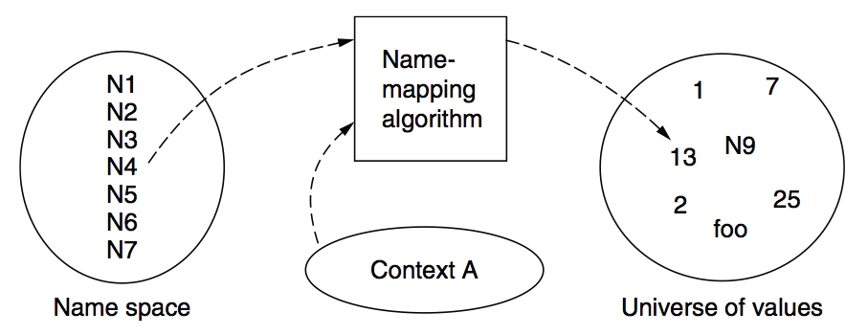
Naming Model

Slide 59
Naming Terminology
Binding – A mapping from a name to value
  Unbind is to delete the mapping
  A name that has a mapping is bound
A name mapping algorithm resolves a name

Slide 60
Naming Context
Type-1: context and name are separated
  E.g., inode number’s context is the file system
Type-2: context is part of the name
  E.g., xiayubin@sjtu.edu.cn
Name spaces with only one possible context are called universal name spaces
  Example: credit card number, UUID, email address

Slide 61
Determining Context - 1
Hard code it in the resolver
  Examples: Many universal name spaces work this way
Embedded in name itself
  cse@sjtu.edu.cn:
    Name = “cse”
    Context = “sjtu.edu.cn”
  /ipads.se.sjtu.edu.cn/courses/cse/README :
    Name = “README”
    Context = “/ipads.se.sjtu.edu.cn/courses/cse”

Slide 62
Determining Context - 2
Taken from environment (Dynamic)
  Unix cmd: “rm foo”:
    Name = “foo”, context is current dir
    Question: how to find the binary of “rm” command?
  Read memory 0x7c911109:
    Name = “0x7c911109”,
    Context is thread’s address space
Many errors in systems due to using wrong context

Slide 63
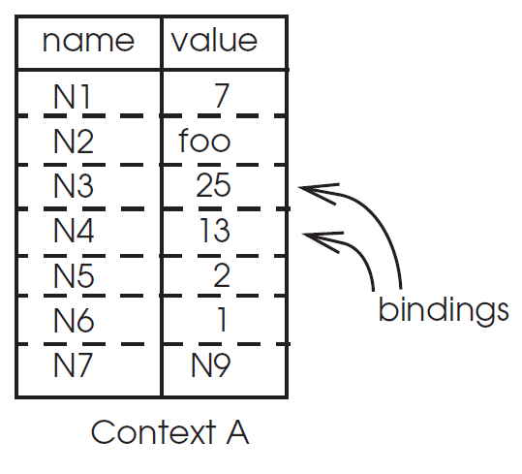
Name Mapping Algorithms - 1
Table lookup
  Find name in a table
    E.g., Phone book
  Context: which table?
    Implicit VS. explicit
    Default context

Slide 64
Name Mapping Algorithms - 2
Recursive lookup
  E.g., “/usr/bin/rm”
  First find “usr” in “/”, then find “bin” in “/usr”, then “rm”
  Each look-up process is the same
Multiple lookup
  Recall: how to find “rm” without absolute name?
  $PATH
    E.g., “/usr/local/sbin:/usr/local/bin:/usr/sbin:/usr/bin:/sbin:/bin”
  Look-up in a predefined list of context

Slide 65
Interpreter Naming API
value ← RESOLVE(name, context)
  Return the mapping of name in the context
status ← BIND(name, value, context)
  Establish a name to value mapping in the context
status ← UNBIND(name, context)
  Delete name from context
list ← ENUMERATE(context)
  Return a list of all bindings
result ← COMPARE(name1, name2)
  Check if name1 and name2 are equal

Slide 66
FAQ of Naming Scheme - 1
What is the syntax of names?
What are the possible value?
What context is used to resolve names?
Who specifies the context?
Is a particular name global (context-free) or local?

Slide 67
FAQ of Naming Scheme - 2
Does every name have a value?
  Or, can you have “dangling” names?
Can a single name have multiple values?
Does every value have a name?
  Or, can you name everything?
Can a single value have multiple names?
  Or, are there synonyms?
Can the value corresponding to a name change over time?

